Slide 1
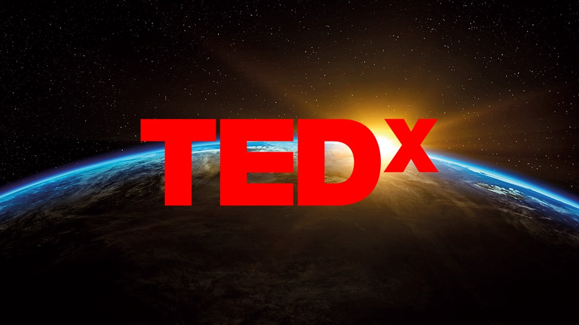
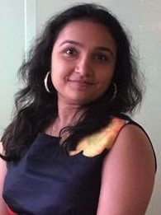



Can we predict popularity of videos ?
Kristina Padia
Madhulika Sharma
Janiece
Pandya
Tej Modi

Slide 2

Founder : Richard Saulman
Co-Founder : Harry Marks
Birth Year: 1984
Aim: To spark ideas & conversation.
Non Profit Organisation.
Experts converge from Technology, Entertainment, Design with it extended its wings in almost all the topics of the world.
Multi-Lingual TED Conferences with a count of more than 100.
Mecca of ideas with short and powerful talks.
TED with TEDx published more than 2000 talks.

Slide 3
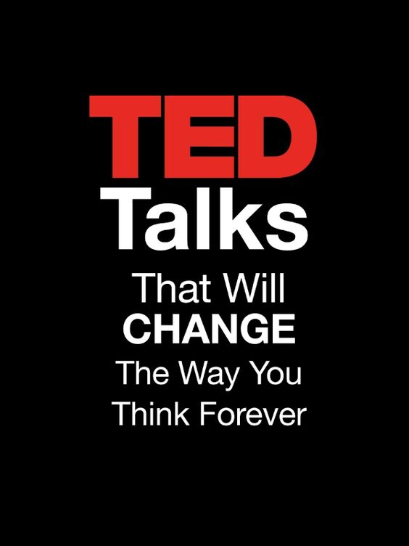
Assumption for this project
Last Update : September 21st, 2017
Brief about the Project:
Feature extraction for “Top 35 Tags” out of the total of 469.
Along with “Top 10 Occupations” of 1351 speakers.
Few features are considered.
More features = More chances of overfitting the model.
Add a footer
‹#›

Slide 4

How will different features affect the popularity of the videos?
Language Used : Python
Runthrough of the project :
Exploratory
Feature Extraction
Regression model Implementation & Analysis.
Neural Network Algorithm
Word Cloud
Random Forest Model
Recommendation
Conclusion
Add a footer
‹#›

Slide 5
Datasets:
Two datasets are used : ‘ted_main’ and ‘transcripts’
ted_main
Information related to all talks along with their number of views, comments, descriptions, speaker’s information and its titles.
transcripts
Includes the transcripts for all relevant talks that are available on their official website.
Add a footer
‹#›

Slide 6
Familiarize the Dataset:
Name | Description | Data type
Comments | The number of first level comments made on the talk | Numeric
Description | A blurb of what the talk is about | String
Duration | The duration of the talk in seconds | Numeric
Event | The TED/TEDx event where the talk took place | String
Film_date | The Unix timestamp of the filming | Numeric
Languages | The number of languages in which the talk is available | Numeric
Main_speaker | The first named speaker of the talk | String
Views | The number of views on the talk | Numeric
Add a footer
‹#›

Slide 7
Familiarize the Dataset:
Name | Description | Data type
Name | The official name of the TED Talk. Includes the title and the speaker. | String
Num_speaker | The number of speakers in the talk | Numeric
Published_date | The Unix timestamp for the publication of the talk on TED.com | Numeric
Ratings | A stringified dictionary of the various ratings given to the talk (inspiring, fascinating, jaw dropping, etc.) | String
Related_talks | A list of dictionaries of recommended talks to watch next | String
Speaker_occupation | The occupation of the main speaker | String
Tags | The themes associated with the talk | String
Title | The title of the talk | String
Add a footer
‹#›

Slide 8
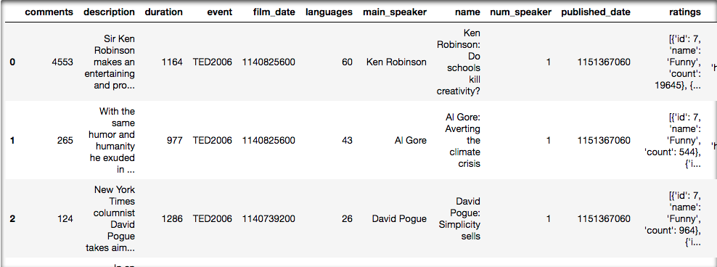
Our Dataset sample:
Add a footer
‹#›

Slide 9
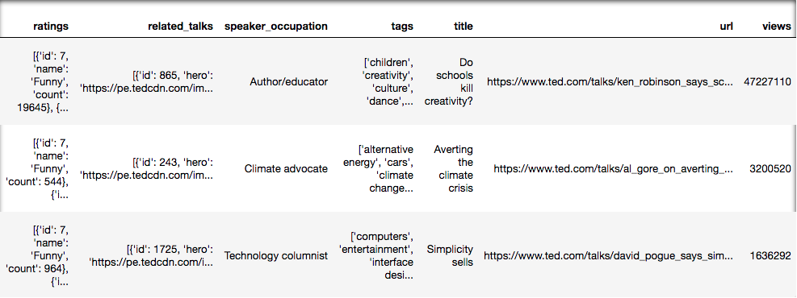
Our Dataset sample:
Add a footer
‹#›

Slide 10
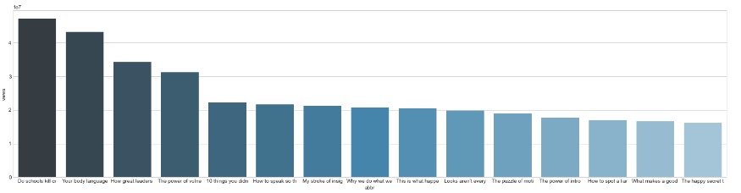
For Exploratory Data Analysis:
Most Popular TED Talk based on Views?
Add a footer
‹#›

Slide 11
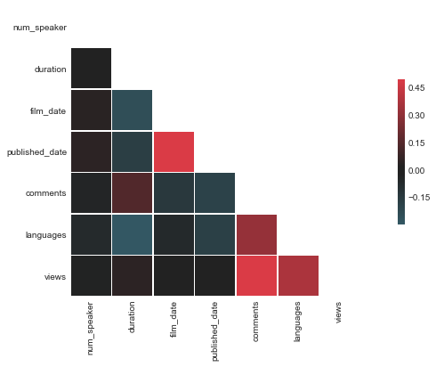
For Exploratory Data Analysis:
Most Influencing factors for video success?
Correlation Coefficient.
Pearson Coefficient also known as Bivariate Correlation.
Find Linear Correlation between selected columns with respect to each other.
Values | Linear Correlation (LC)
-1 | Negative LC
0 | No LC
+1 | Positive LC
Add a footer
‹#›

Slide 12
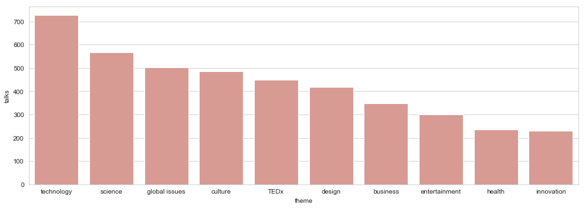
For Exploratory Data Analysis:
Most Popular Genre?
Add a footer
‹#›

Slide 13
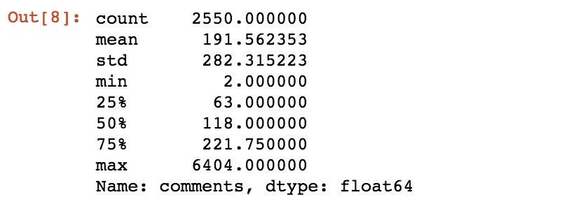
For Exploratory Data Analysis:
How often do people comment on TED Talk?
On average, there are 191.5 comments on every TED Talk. The minimum number of comments on a talk is 2 and the maximum is 6404.
Add a footer
‹#›

Slide 14
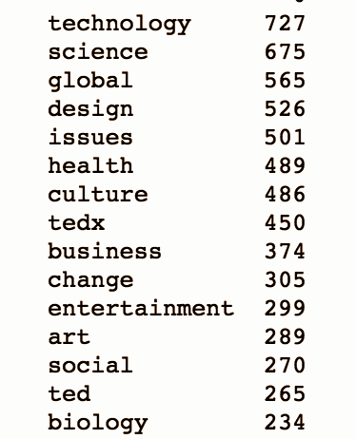
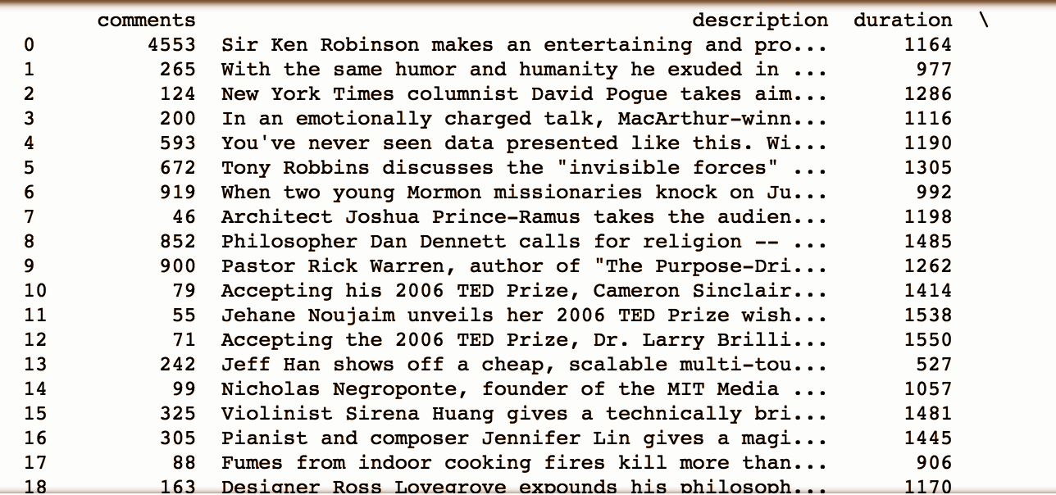
Feature Extraction Data Analysis:
Tag Extraction (Top 35):
Sentiment Polarity Extraction:
Output: (2550,52 )
Output: (2467, 55)

Slide 15
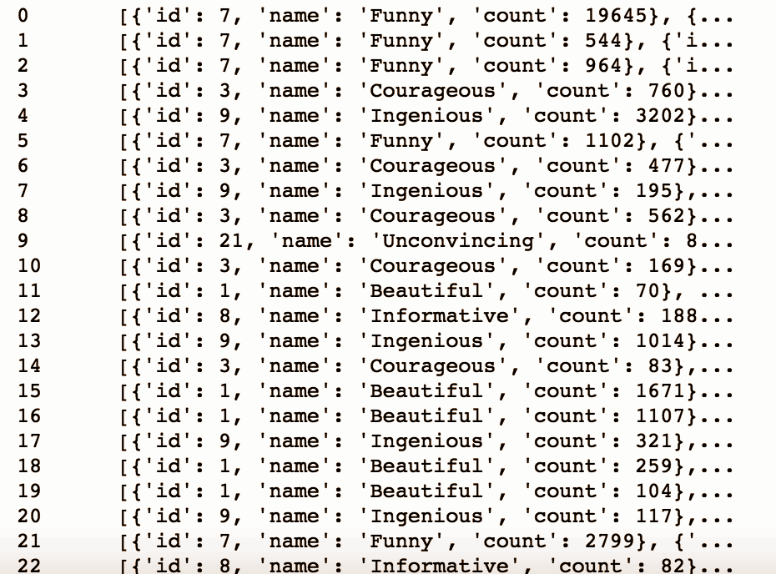
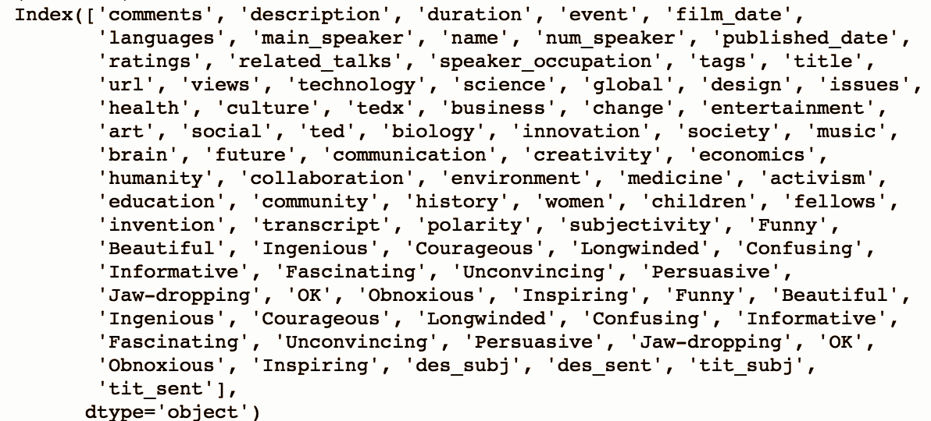
Contd..
Ratings Extraction
Description & Title Subjectivity Extraction
Output: (2467,83)
Output: (2467, 87)

Slide 16
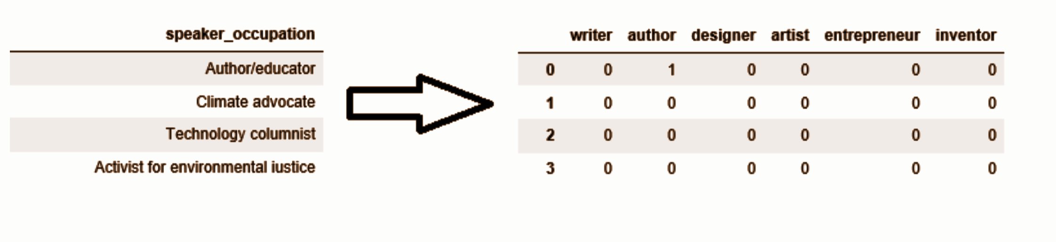
Contd..
Speaker Occupation Extraction
Output: (2467,83)
Add a footer
‹#›

Slide 17
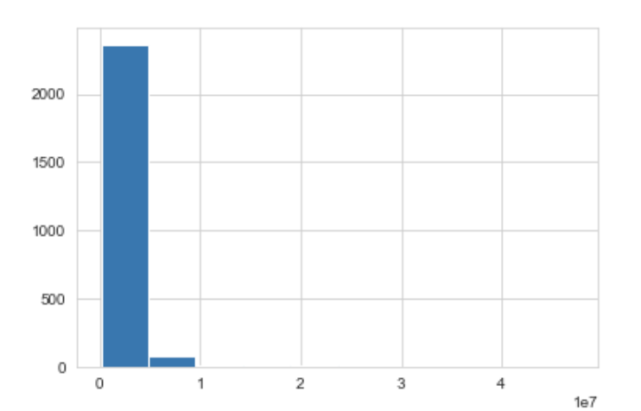
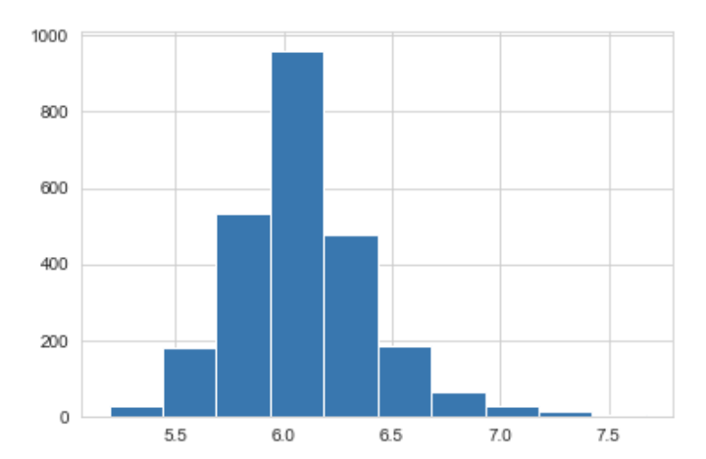
Complete plotting for all Extractions:
plt.hist((result['views']))
plt.hist(np.log10(result['views']))

Slide 18
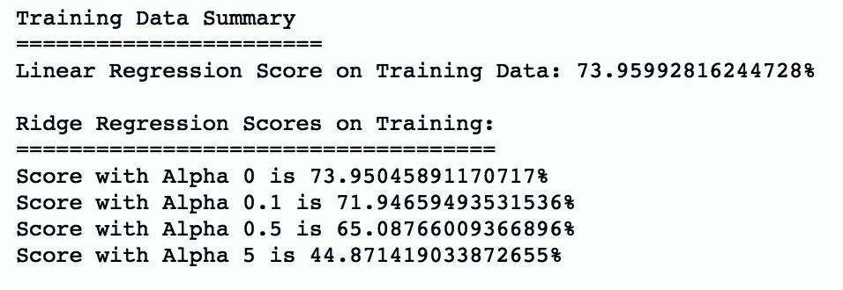
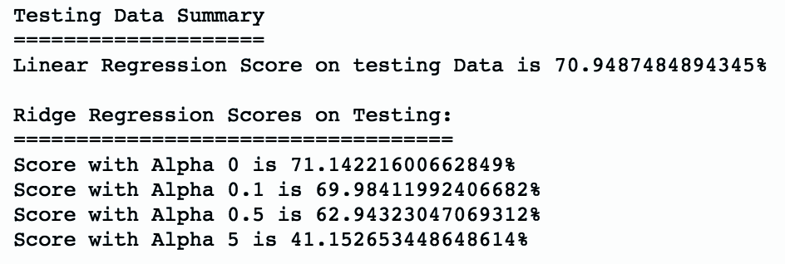
Regression Model Implementation & Analysis:
Regression Result on Training Set:
Regression Result on Test Set:
Add a footer
‹#›

Slide 19
Neural Network Algorithm & Training:
Algorithm Steps:
Update Parameter for n iterations
5
Gradient Derivative
44
Backward Propagation
3
Calculate Cost
242
FABRIKAM RESIDENCES
Forward Propagation
15

Slide 20
Neural Network Algorithms:
3 layers with (100,50,1) hidden units are designed with following options:
Hyper Parameters Initialization
HE Initialization
Forward Propagation
L layers use Relu activation function
Regularization
Lambda with L2 regularization
Cost
MSE
Optimization
Gradient Descent Algorithm
FABRIKAM RESIDENCES

Slide 21
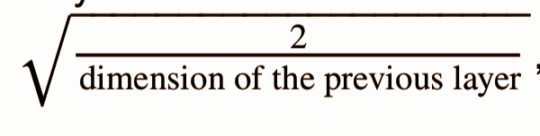
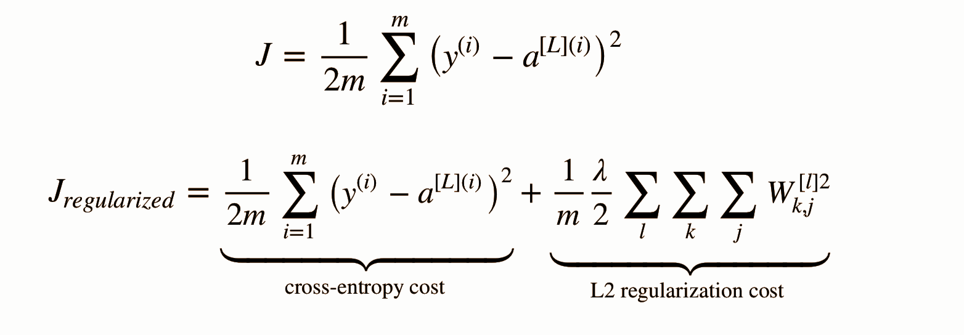
Neural Network Algorithm & Training:
Hyper Parameter (W, b) Initialization
HE Initialization : This function is similar to the previous initialize_parameters_random(...). The
only difference is that instead of multiplying np.random.randn(..,..) by 10, you will multiply it by,
which is what He initialization recommends for layers with a ReLU
activation.
Cost Computation :
L2 Regularization
FABRIKAM RESIDENCES

Slide 22
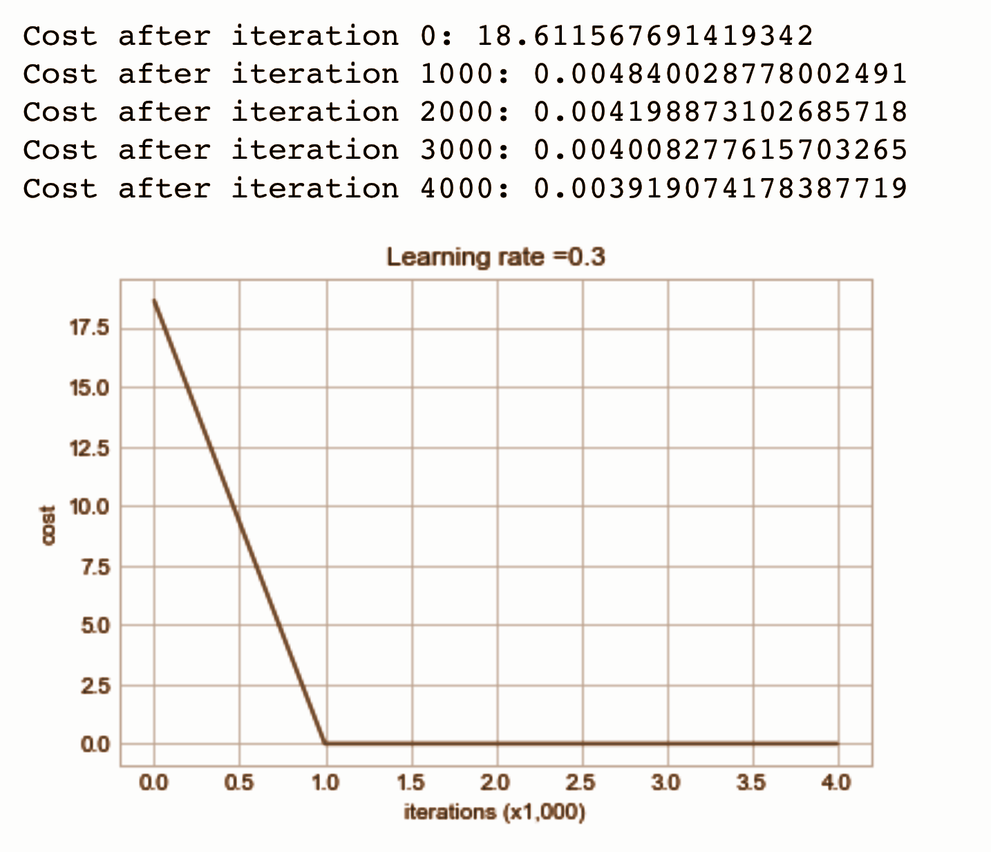
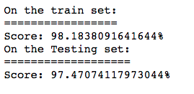
Neural Network Algorithm & Training:
Back Propagation
Updating Hyper Parameters Based on Gradient Descent Derivative
Deep Learning Model
FABRIKAM RESIDENCES

Slide 23
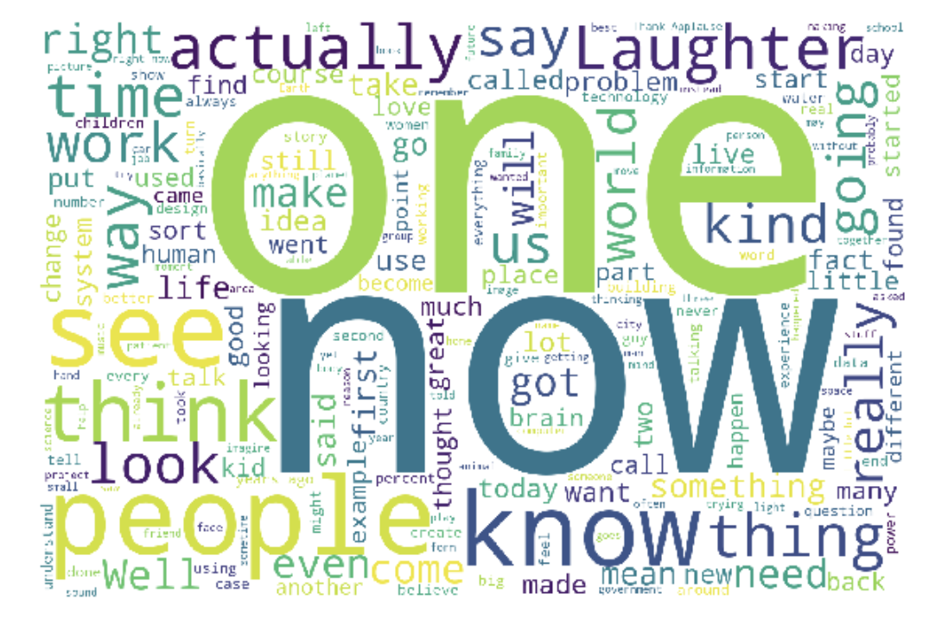
Word Cloud:
Represents the frequency or the importance of each word
For our project we check for Stop words used in the videos and plot it.
Most used stop words in popular videos are :
now , one
FR
FABRIKAM RESIDENCES

Slide 24
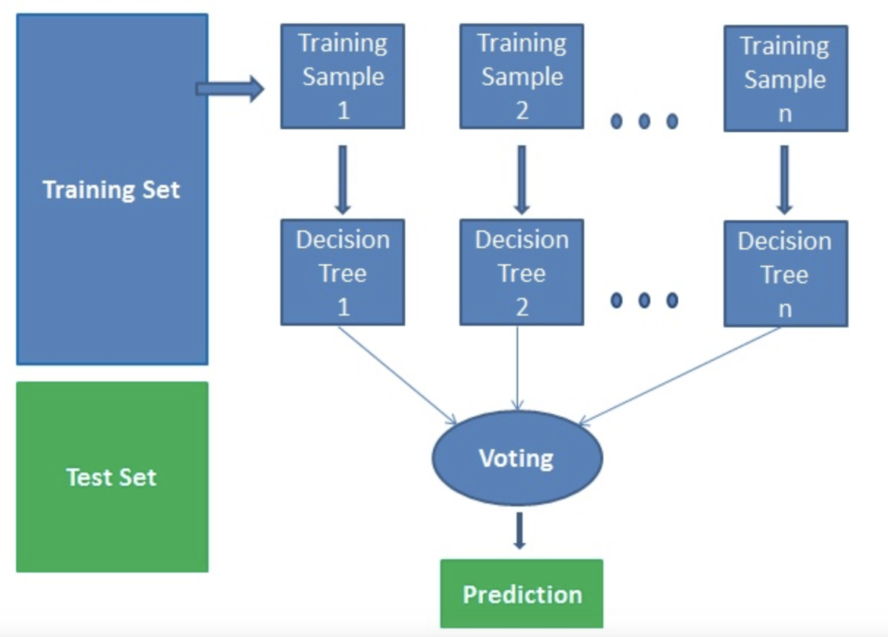
Random Forest Model:
Random forest algorithm is a supervised classification algorithm. As the name suggest, this algorithm creates the forest with a number of trees.
For our project to build the RF Model :
We excluded those that are non-TED events and considered tags and and speaker population to get famous and not so famous videos
Used CountVectorizer to get the collection in matrix
Used RandomForestClassifier : creates a set of decision trees from randomly selected subset of training set. It then aggregates the votes from different decision trees to decide the final class of the test object
Computed confusion matrix to evaluate the accuracy of the classification
FR
FABRIKAM RESIDENCES

Slide 25
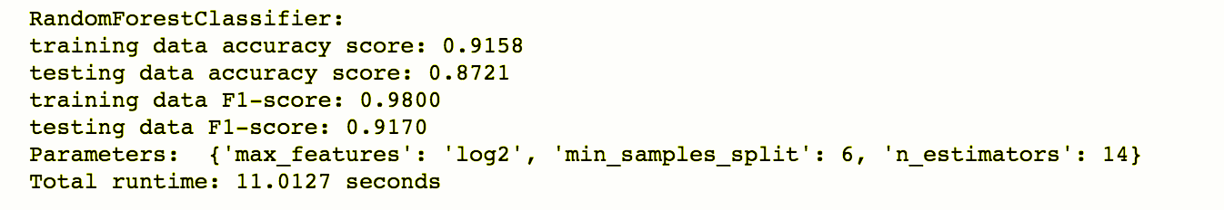
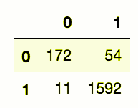
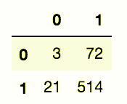
Random Forest Model:
We are building prediction model using tags and speaker occupation columns to. We will predict popular talk. Calculate the accuracy.
FR
FABRIKAM RESIDENCES
Confusion matrix
Train
Test

Slide 26
Conclusion:
Future Work
TED organization can employ this model to predict the wide reach or popularity of new videos.
For an instance, when a new talk is published under a certain category i.e. Technology, Education, etc. and talk duration, Speaker, Tags this model will predict the popularity with 97.4% confidence.
Next TED Talk recommendation system can be developed just as YouTube.
Transcripts of all the talks can be translated into other languages using machine translation system employing Deep Neural Network, Sentimental Analysis

Slide 27
References:
~ Banik, Rounak. TED Talks. 25 Sept. 2017, www.kaggle.com/rounakbanik/ted-talks.
~ Banik, Rounak. TED Talks. www.kaggle.com/rounakbanik/ted-data-analysis.
~ www.ted.com
https://medium.com/machine-learning-101/chapter-5-random-forest-classifier-56dc7425c3e1
~https://www.datacamp.com/community/tutorials/random-forests-classifier-python
FR
FABRIKAM RESIDENCES

Slide 28

FR
FABRIKAM RESIDENCES

